Slide 1
BDT CS523 - PROJECT
Tamir Batbayar
611144

Slide 2
ENVIRONMENT
HOST: google cloud
Hadoop: Hadoop-3.2.2
Hbase: hbase-2.2.4-bin
Hive: apache-hive-3.1.2-bin
Kafka: kafka_2.12-2.6.0
Spark: spark-3.1.2-bin-hadoop3.2

Slide 3

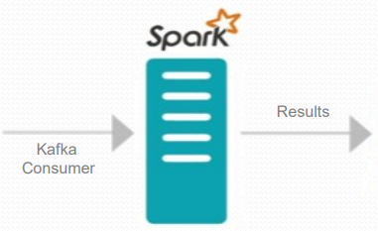

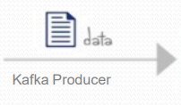
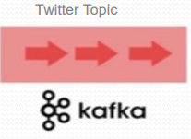


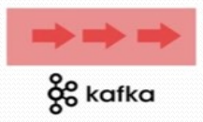
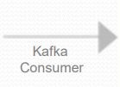
Hashtag
Count
Console
Spark Streaming API
Spark Streaming API
Mentions topic
Console
Mentions list
Spark Streaming API

Slide 4
Appendix - 1
####SERVICES
# start hadoop
start-all.sh
# start hbase with zookeeper
start-hbase.sh
# start kafka (zookeeper is already starts with hbase)
# zookeeper-server-start.sh $KAFKA_HOME/config/zookeeper.properties #OPTIONAL you can use it if zookeeper is no running
kafka-server-start.sh $KAFKA_HOME/config/server.properties
#check running application
jps
ps -ef | grep zookeeper

Slide 5
Appendix - 2
#####CONSUMERS
#create kafka topics
kafka-topics.sh --create --zookeeper localhost:2181 --replication-factor 1 --partitions 1 --topic twitter_topic
kafka-topics.sh --create --zookeeper localhost:2181 --replication-factor 1 --partitions 1 --topic mentions_topic
#check kafka topics
kafka-topics.sh --list --zookeeper localhost:2181
#start hashtag counter
spark-submit --packages org.apache.spark:spark-sql-kafka-0-10_2.12:3.1.2 kafkaCountHashtags.py localhost 9092 twitter_topic
#start kafka consumer
kafka-console-consumer.sh --bootstrap-server localhost:9092 --topic mentions_topic

Slide 6
Appendix - 3
####PRODUCERS
#start split mentions producer
spark-submit --packages org.apache.spark:spark-sql-kafka-0-10_2.12:3.1.2 kafkaMentionsProducer.py localhost 9092 twitter_topic mentions_topic
#start tweet producer
python3 kafkaTweetProducer.py localhost 9092 twitter_topic "bitcoin crypto NFT"

Slide 7
Appendix – 4
#####TESTING PURPOSES
#starting kafka producer
kafka-console-producer.sh --broker-list localhost:9092 --topic twitter_topic

